Slide 1
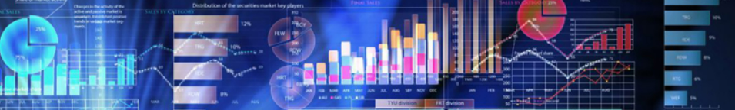
TABLEAU CAPSTONE PROJECT 2022
1
PRESENTED BY: DINESH KUMAR CHOUBEY

Slide 2
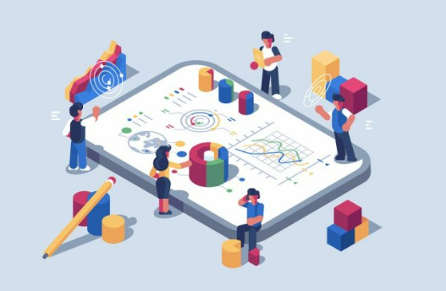
INTRODUCTION
2
In this project I am using Indian online superstore dataset.
This dataset has retail data of four years (2011-2014).
This dataset was downloaded from (https://www.kaggle.com/datasets).
This dataset has 18 columns and 1556 rows.

Slide 3

PROBLEM STATEMENTS OVERVIEW
3
What was Sales / Profit trend throughout the year ?
What was state wise performance ?
What was segment wise performance ?
Which category has best performance ?
Sub-category wise performance ?
Which products are Top selling and most profitable?
Top and bottom customers in terms of sales and profit ?

Slide 4

EXECUTIVE SUMMARY
4
In this project we are performing EDA for analyzing and investigating this data set and to summarize its main characteristics, and creating dashboard using visualization methods.
In this dataset we have retail data of a superstore I’ve used tableau public to analyze and visualize data to solve my problem statements.
Tableau Workbook and Explanation Video Link- https://drive.google.com/drive/folders/1et1S6JVQYqxPPmwGqCLiSm-T3ostQEYl?usp=sharing

Slide 5
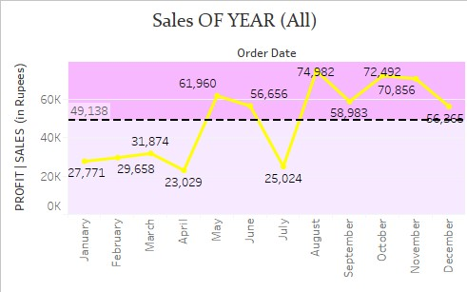
What was Sales / Profit trend throughout the year ?
5
This line chart is showing sales trend of all 4 years.
We can change measure to profit by using dropdown parameter.
We can also see trend of any year using list filter created using sets.
Here we can see the sales in month of August and October are highest due to festive season but profit is highest in October and November(when profit is selected).

Slide 6
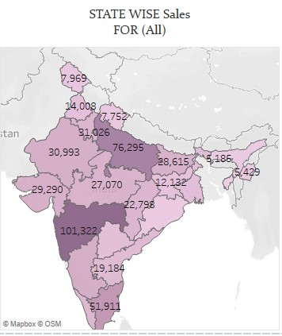
What was state wise performance ?
6
From this map chart we can see state wise sales and profit of any state and compare them.
We can change measure to profit by using dropdown parameter.
We can also see values of any year using filter.
Here we can see Uttar Pradesh and Maharashtra has highest number of sales and profit.

Slide 7
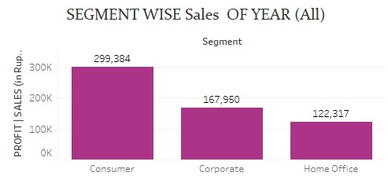
What was segment wise performance ?
7
Here In this column chart we can easily see Consumer segment had highest sales.
We can change measure to profit by using dropdown parameter.
We can also see values of any year using year filter.

Slide 8
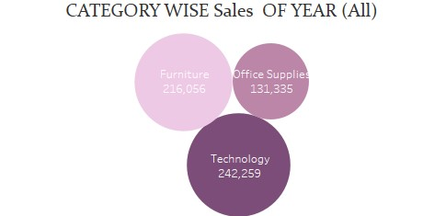
Which category has best performance?
8
In this bubble chart we can see category wise sales/profit.
Here size of bubble is directly proportional to sales/profit, higher the sales bigger the bubble.
For all years Technology category has highest sales.

Slide 9
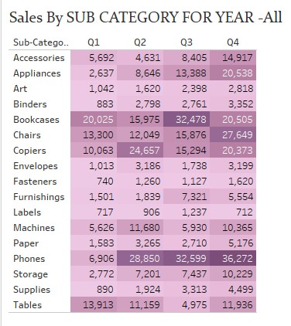
Sub-category wise performance ?
9
This heat map chart shows Quarter wise sales/profit of sub categories for all years or any selected year.
Heat map is used to encode values in color like here we can see dark colored cells showing higher values and lighter ones are less.
From this chart we can see phones sub category has best performance throughout the year and it has highest sales in Q4.

Slide 10
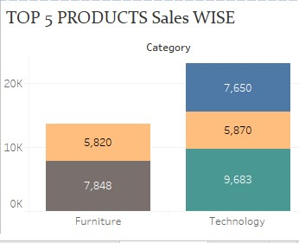
Which products are Top selling and most profitable?
10
From this stacked bar chart we can see category wise performance of products.
Here we can select top (n) number of products by using given slider parameter.
From this we can see that Apple Smart Phone is highest selling and profitable product in our store.

Slide 11
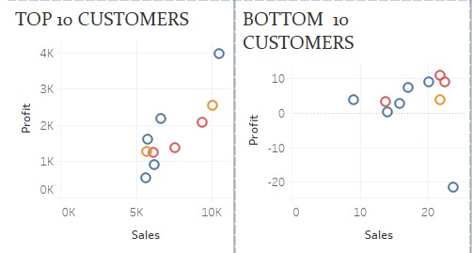
Top and bottom customers in terms of sales and profit ?
11
These two scatter plots show top and bottom (n) customers In terms of sales and profit.
We can look for 1 to 50 top customers using parameter slider.
From this we got to know that Cynthia Arntzen is Number 1 customer with sales of Rs.10,463 and profit of Rs.3,982 .

Slide 12
CONCLUSIONS
12
Sales in month of August and October are highest due to festive season.
Uttar Pradesh and Maharashtra has highest sales and profit.
Consumer segment had highest sales and profit.
Technology category is most popular category with highest sales and profit.
Phones sub category has best performance throughout the year and it has highest sales in Q4.
Top 5 products are from furniture and technology category.
Most popular product is Apple phone Full size.
Cynthia Arntzen is Number 1 customer with sales of Rs.10,463 and profit of Rs.3,982 and customer with least sales and profit is Dan Lawera.

Slide 13
THANK YOU

